Slide 1

AGENDA
Introduction – Leon Heydenrich – Micro Focus
Setting the scene - Vodacom – Masiza Qutu - Manager, SDQA Testing, Mobile Engineering
Micro Focus ALM Octane Demo – Vodacom -Pheta Moloi/Thandi Khoza
C3 – Vodacom confidential
1

Slide 2

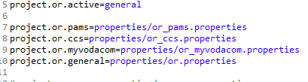
Automation Framework Architecture
Driver Script
Run
Automation Test Script
Selenium Hybrid Framework
ALM Quality Center
Object Repository
Input Data Processor
Data
Global Variables
Reporting
Extent Report
Qlick Sense
C3 – Vodacom confidential
2

Slide 3

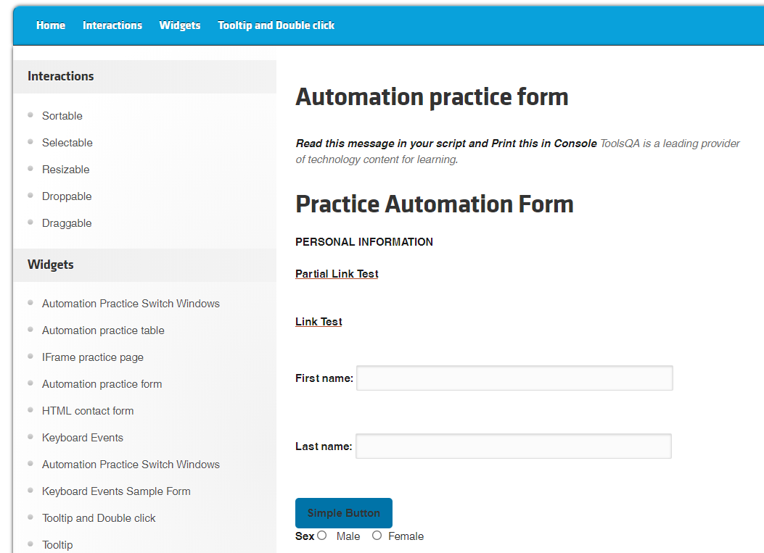


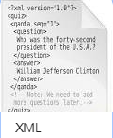
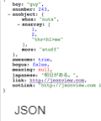


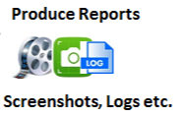
Test Automation Flow
Test Automation Framework
Supported Browsers
Qlick Sense
API Automation
FMW
CCS
ALM Quality Center
API
Reporting Tools
Automation Test Engineer
Xcel Input Data

Slide 4
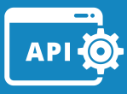

Octane Cucumber automation Flow
GIT
Automated Test Suite Project.
CI SERVER
JENKINS
Jenkins Node.
Selenium Server
System under Test, where the Test Execution takes place.
Job pulls Test Suite from Git.
Builds & Executes.
TEST EXECUTION MACHINE
SOAP/REST
SOAP
LDAP
CUR
CCS
Automation Test Engineer
Download Gherkin script from Octane and automate
Multiple ATE work on one automated test suite with master in GIT
Using Intellij plugin, they download Feature Files, Automate and Update their work on Octane directly from the ide.
GIT
Octane
My Work
Store Manual and Gherkin Tests.
Integrate with Jenkins to Execute job.
Update Tests with Results.
Gherkin Script

Slide 5












POC Integration Architecture for Vodacom eng.
IDE
SCM
CI Servers
1
1
1
3
Unit Testing
UFT Dev
Octane
DevSecOps
4
1
UFT
Mobile
Analytics & Reporting
Sprinter
Functional Testing
3
UFT One
2
5
4
JIRA
LoadRunner
App Security
Agile Platform
ALM DevSecOps Platform
Performance Validation

Slide 6



Slide 7
Thank You
7
Insert Confidentiality level | 25 November 2021

